Slide 1
INTRODUCTION
Our project is a web application that helps users search for flights between two cities, explore popular travel routes, view airport information, and get travel tips — all in one platform.
The Airline Reservation System is a web-based application designed to automate the process of booking and managing airline tickets.I t provides an efficient,user-friendly platform for users to search available flights,make reservations and view booking history.
This project is developed using:
Django: A high-level Python web framework that enables rapid development and clean, pragmatic design.
MySQL: A robust and scalable relational database used to store ancd manage user,flight and booking data.

Slide 2
OBJECTIVES
The objective of this project is to develop a web-based Airline Reservation System using HTML and CSS for the front end and Python for the back end. The system provides a user-friendly interface for tasks such as:
Searching available flights
Viewing popular routes
Accessing airport information
Tracking live flight statuses
This system aims to simplify the flight booking and tracking process for users

Slide 3
FEATURES
Search Flights:
Choose where you want to go.
Pick dates to travel.
See different flight options.
Compare prices and times.
Book the one that fits you best

Slide 4
Popular Flights:
The most traveled routes.
Favorite destinations many people choose.
Flights that are often booked.
Good options if you’re not sure where to go.
Airport Information:
Details about the airport(terminals,lounges).
Food and shops available.
How to get to and from the airport.
Flight arrivals and departures.
Weather and other useful tips.nm

Slide 5
KEY MODULES
USER MODULE: Users can register,log in and manage their profiles.
ADMIN MODULE: Admin can add,update or delete flight details.
FLIGHT SEARCH: Users can search for flights by source,destination and date.
BOOKING SYSTEM: Users can select a flight,enter passenger details and confirm the booking.
BOOKING HISTORY: Users can see their past bookings and cancel if needed.

Slide 6
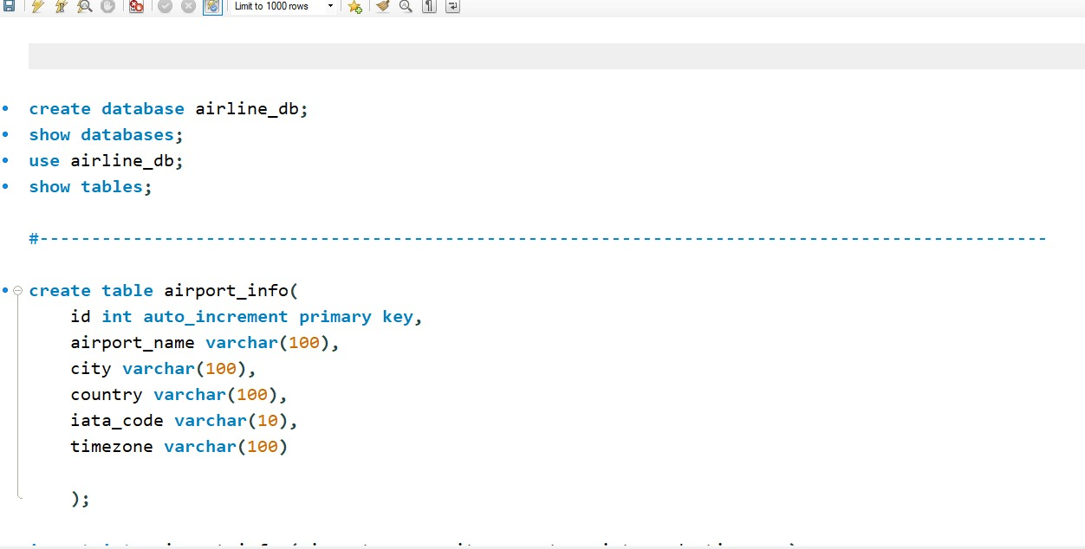
DATABASE IMAGES

Slide 7
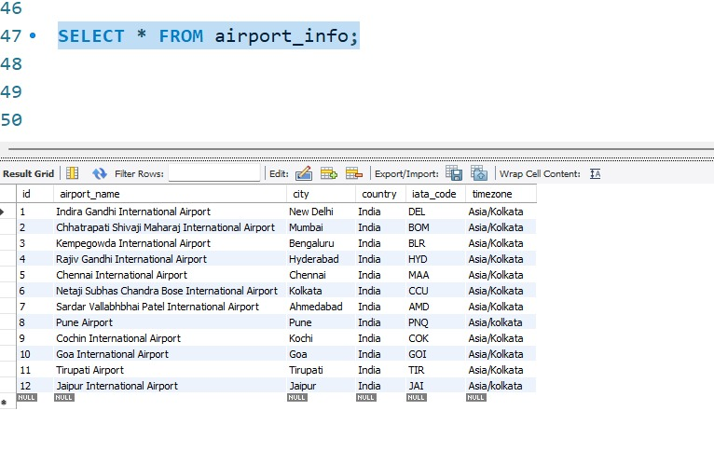

Slide 8
TOOLS & TECHNOLOGIES
Backend: DJANGO(Python Framework)
Handles the logic of the website like login,booking and managing data.
Database: MySQL
Stores all the data such as user,flights and bookings.
Frontend: HTML,CSS,JS
Used to design the web pages and make them look good and work well on different devices.

Slide 9
FUTURE SCOPE
Online Payment intergration: Let users pay for tickets online.
Choose Seats: Allow users to pick their own seats when booking.
Mobile App: Make a phone app so users can books from anywhere.
Send Alerts: Send messages or emails about booking or flight changes.
Flight Updates: Show if a flight is late or canceled.

Slide 10
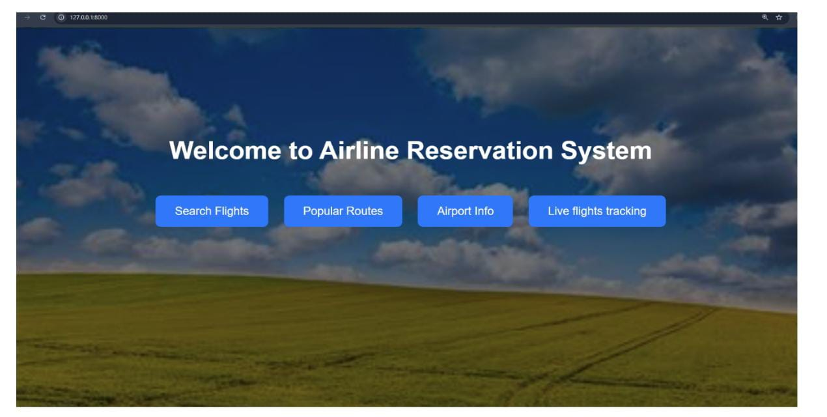
This is my home page which is created by using HTML,CSS &Python. 1.Home Page – This is the starting page with navigation buttons to other features.

Slide 11
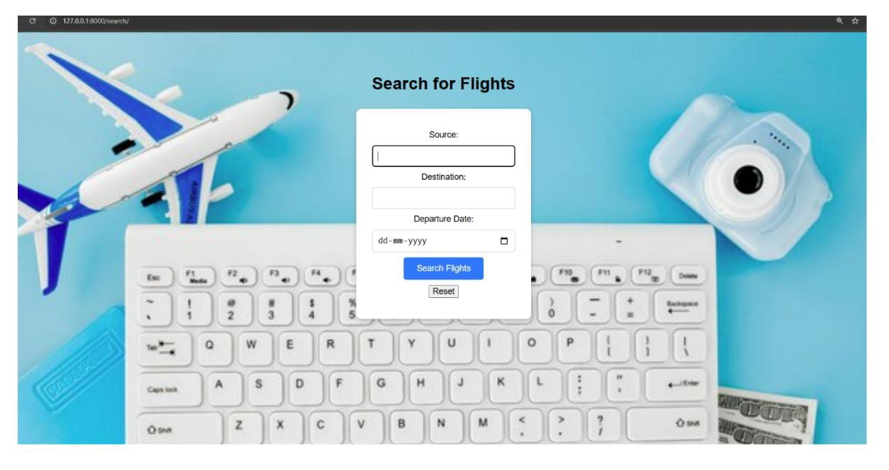
My home page has 4 buttons which display these: 2. Search Flights Page – Users can enter source, destination, and date to get flight results using the AviationStack API.

Slide 12
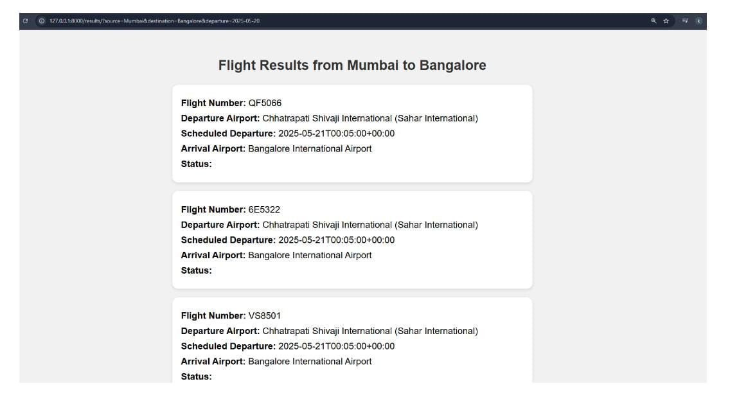
Output will be in this form: 3.Result page - gives result of flights sent through APIS.

Slide 13
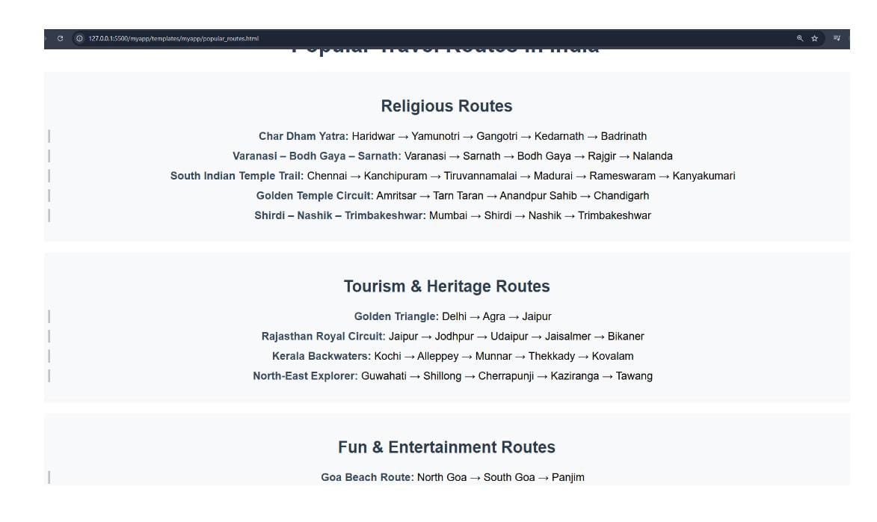
Next button which will suggest people to travel to routes according to their choice: 4. Popular Routes Page – Lists famous travel routes categorized by religious, tourism, nature, and entertainment purposes.

Slide 14
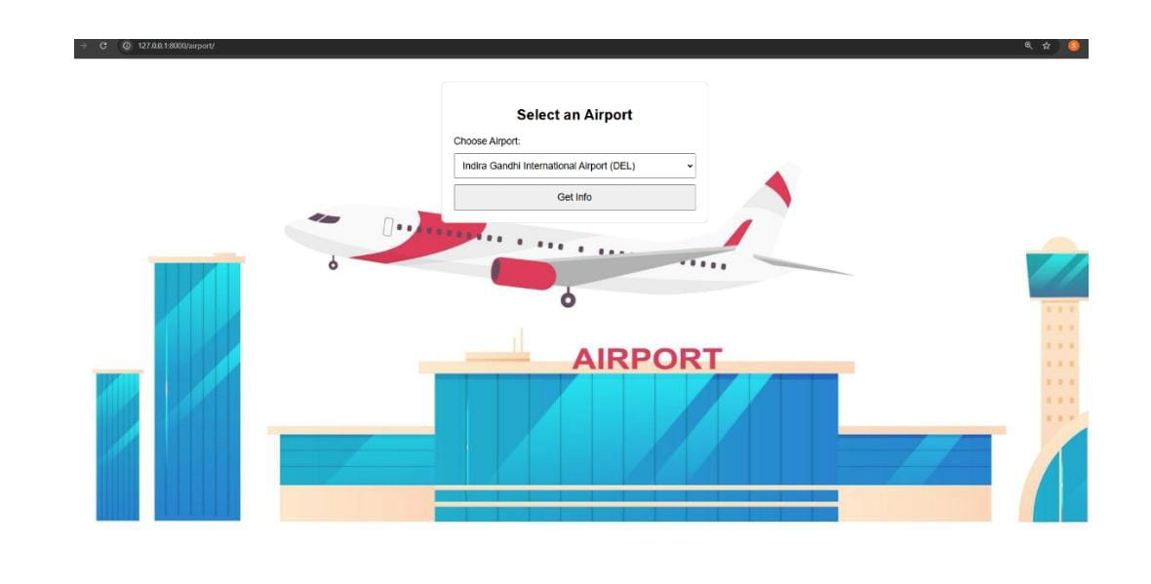
5. Airport Info Page – A form allows users to choose an airport, and we fetch its info from the database. 6.airport_result Page - when user clicks on get info button this page fetch airport info through database.

Slide 16
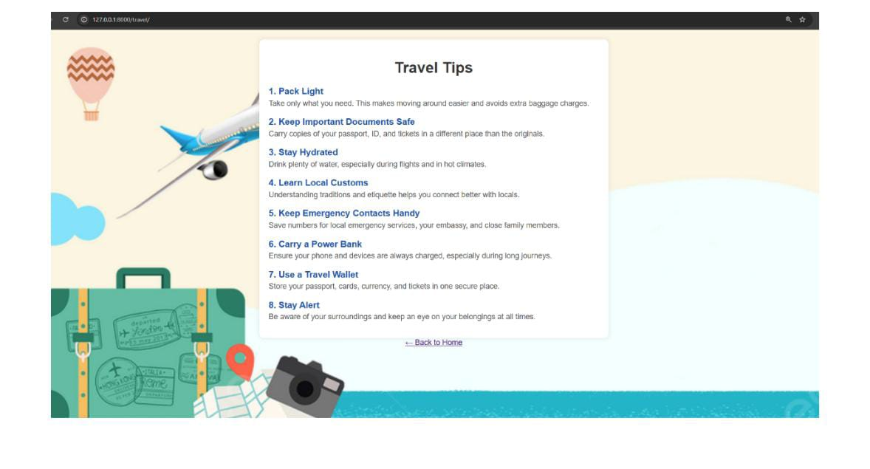
Then some travel tips provide to viewers: 7. Travel Tips Page – Provides essential travel safety and packing tips.

Slide 17
CONCLUSION
The Airline Reservation System project successfully demonstrates how web technologies like HTML, CSS, and Python can be integrated to build a functional and interactive application.
The homepage provides a clear and attractive user interface that guides users to key features such as flight search, route information, airport details, and live flight tracking.
Overall, the project achieves its goal of making flight-related services more accessible and organized, laying the foundation for a fully operational airline booking system.

Slide 18

GITHUB LINK
https://github.com/Shruti-0201/Airline-reservation-system.git

